Slide 1
CONTEMPORARY STRATEGIC ISSUES & MANAGERIAL CHOICES [CSIMC]
Term VI, AY 2026-27
Course Objectives- Content-Schedule of Sessions- Evaluation

Slide 2
CONTEMPORARY STRATEGIC ISSUES & MANAGERIAL CHOICES [CSIMC]
Faculty: Professor Ranjan Das Professor of Strategic Management
Industry Experience:
  20 Years in Industry [pre & post PhD in Strategic Management from IIM Ahmedabad]
Faculty & Consulting Experience:
  32 years [ IIM Calcutta and other business schools in India and select overseas business schools]
Experience as an Entrepreneur:
  18 years [overlapping with teaching & consulting assignments during 2008 onwards]
MOBILE: 09830052722; Email: rdas@iimcal.ac.in

Slide 3
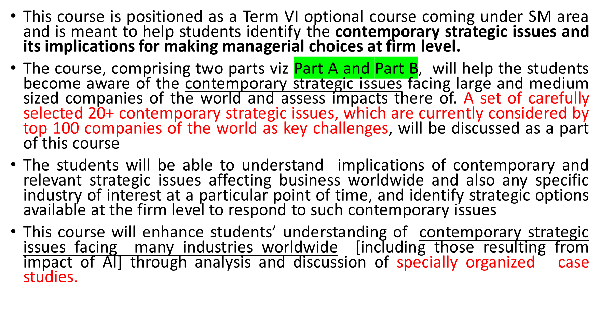
CSIMC : FOCUS AREAS

Slide 4
CSIMC : FOCUS AREAS
Part A and Part B of this course together will assist students in identifying capabilities that are needed by an organizations to identify, source and manage the contemporary strategic challenges on multiple fronts and develop road maps to implement the chosen strategic directions.
The special emphasis on discussion on 20+ contemporary strategic issues that are and will most likely be affecting almost all industries worldwide during 2026-2030 and developing a list of possible strategic choices under each such contemporary strategic issue are added value of this course
The principal purpose of this course is thus to sensitize students about the contemporary developments mentioned under Parts [A] and [B]. The course is expected to help them draw important lessons for making and implementing high-stake decisions within their organizational and industry context.

Slide 5
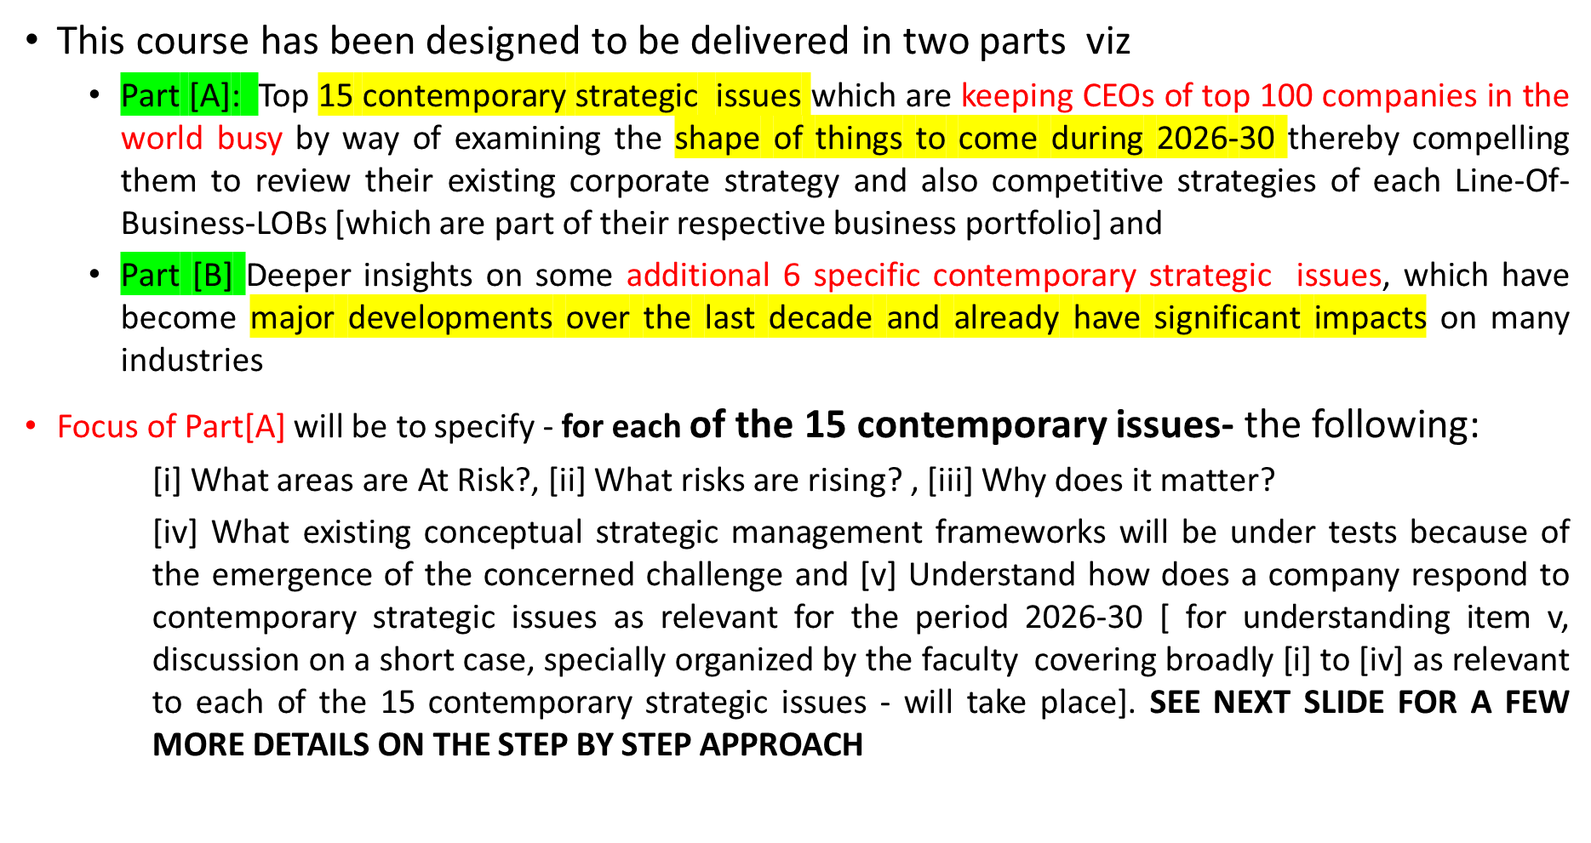
CSIMC: CONTENT TO BE DELIVERED IN TWO PARTS – A &B

Slide 6
CSIMC: CONTENT TO BEDELIVERED IN TWO PARTS – A &B
Focus areas of these 15 contemporary strategic issues coming under PART A and which will be delivered during the first 10 sessions have been listed in the subsequent slides. For each strategic issue, following items will be discussed with recent cases and examples during Sessions 1 to 10:
    What is the challenge and why is it strategic during 2026–30?
    What is “At risk”?
    What is “Rising”?
    Why does it matter during 2026–30?
    Which existing strategy concepts and frameworks are put “at risk”?
    Imagining the emerging future 2026–30: four steps to be applied to imagine the possible future
    What are, and will be, CEOs’ likely strategic responses during 2026–30?
    India lens: how this challenge affects Indian companies
    A case discussion covering relevant issues from i to viii
Content of PART B – comprising second set of 10 sessions – are listed in the slides after PART A.

Slide 7
15 Contemporary Mega Challenges – under PART A - Facing CEOs of Top 100 Companies
Tier 1: Macro and Industry Challenges [2026-30]
Trade War Fragmentation
Middle East Energy & Logistics Shock
Recession Risks
Regulatory Fragmentation
Shrinking Workforce
Tier 2: Challenges while Evaluating Strategic options
6. AI Value Gap
7. Agentic AI Governance
Tier 2: Challenges while Evaluating Strategic options
8. Cyber as Strategic Risk
9. Geopolitical Strategy
10. M&A and Alliances
Tier 3: Organizational Challenges
11. Scarce Skills Talent War
12. Redesigning the Organization
13. New Work Models
14. DEI Reset
15. Innovation Theatre

Slide 8
Tier 1: Macro and Industry Challenges [2026-30]
The Challenge | Brief description of the challenge
1. Trade War Fragmentation | The global trading system is splitting into overlapping, fast-changing tariff regimes that outpace the multi-year cycle of building plants, suppliers and markets.
2. Middle East Energy & Logistics Shock | A live war has closed the world's most important energy and shipping chokepoint for seven months and counting, and firms cannot wait for it to end before deciding how to operate.
3. Recession Risks | A downturn that may or may not arrive on schedule forces CEOs to choose, years in advance and without reliable warning, between cutting now and being caught overextended, or holding steady and being caught unprepared.
4. Regulatory Fragmentation | As the EU, the US, China and India write incompatible rules for the same technologies and markets, a single global operating model becomes a liability, and compliance itself turns into a strategic cost center
5. Shrinking Workforce | With the working-age population falling across most major economies, firms built on an assumption of abundant, affordable labor must redesign how work gets done years before the shortfall becomes visible on the factory floor.

Slide 9
Tier 2: Challenges while Evaluating Strategic options
The Challenge | Brief description of the challenge
6. AI Value Gap | Billions committed to AI capability are outrunning any firm's ability to prove a return, leaving CEOs to decide how long to keep funding a technology whose payoff date keeps moving.
7. Agentic AI Governance | As AI systems move from answering questions to taking actions on their own, firms must build guardrails for failures that have no precedent, before the first major one happens inside their own operations.
8. Cyber as Strategic Risk | A single breach can now erase a year of earnings and years of customer trust overnight, forcing cybersecurity out of the server room and onto the board's strategic agenda.
9. Geopolitical Strategy | With sanctions, export controls and alliance politics now capable of closing a market overnight, a firm's geographic footprint has become a geopolitical bet, not just a commercial one.
10. M&A and Alliances | As technology and trade barriers reshuffle who can compete where, CEOs must decide whether to build, buy or partner their way into a future that will look very different from the industry they inherited.

Slide 10
Tier 3: Organizational Challenges
The Challenge | Brief description of the challenge
11. Scarce Skills Talent War | The skills a firm needs for the next decade, particularly in AI, are scarcer than the capital to pay for them, turning talent acquisition into as much a strategic constraint as market access.
12. Redesigning the Organization | The hierarchical structures built for a pre-AI, pre-remote world are increasingly mismatched to how work actually gets done, forcing a redesign with no proven template to copy.
13. New Work Models | As remote work, gig labor and algorithmic management reshape who does the work and from where, firms must rebuild their operating models around a workforce that no longer shows up the same way twice.
14. DEI Reset | As political and legal pressure reverses a decade of DEI commitments in some markets while entrenching them in others, a single global people policy has become nearly impossible to sustain.
15. Innovation Theatre | With innovation labs and AI pilots proliferating faster than any of them reach the core P&L, CEOs must tell the difference between activity that looks like progress and investment that actually changes the business.

Slide 11
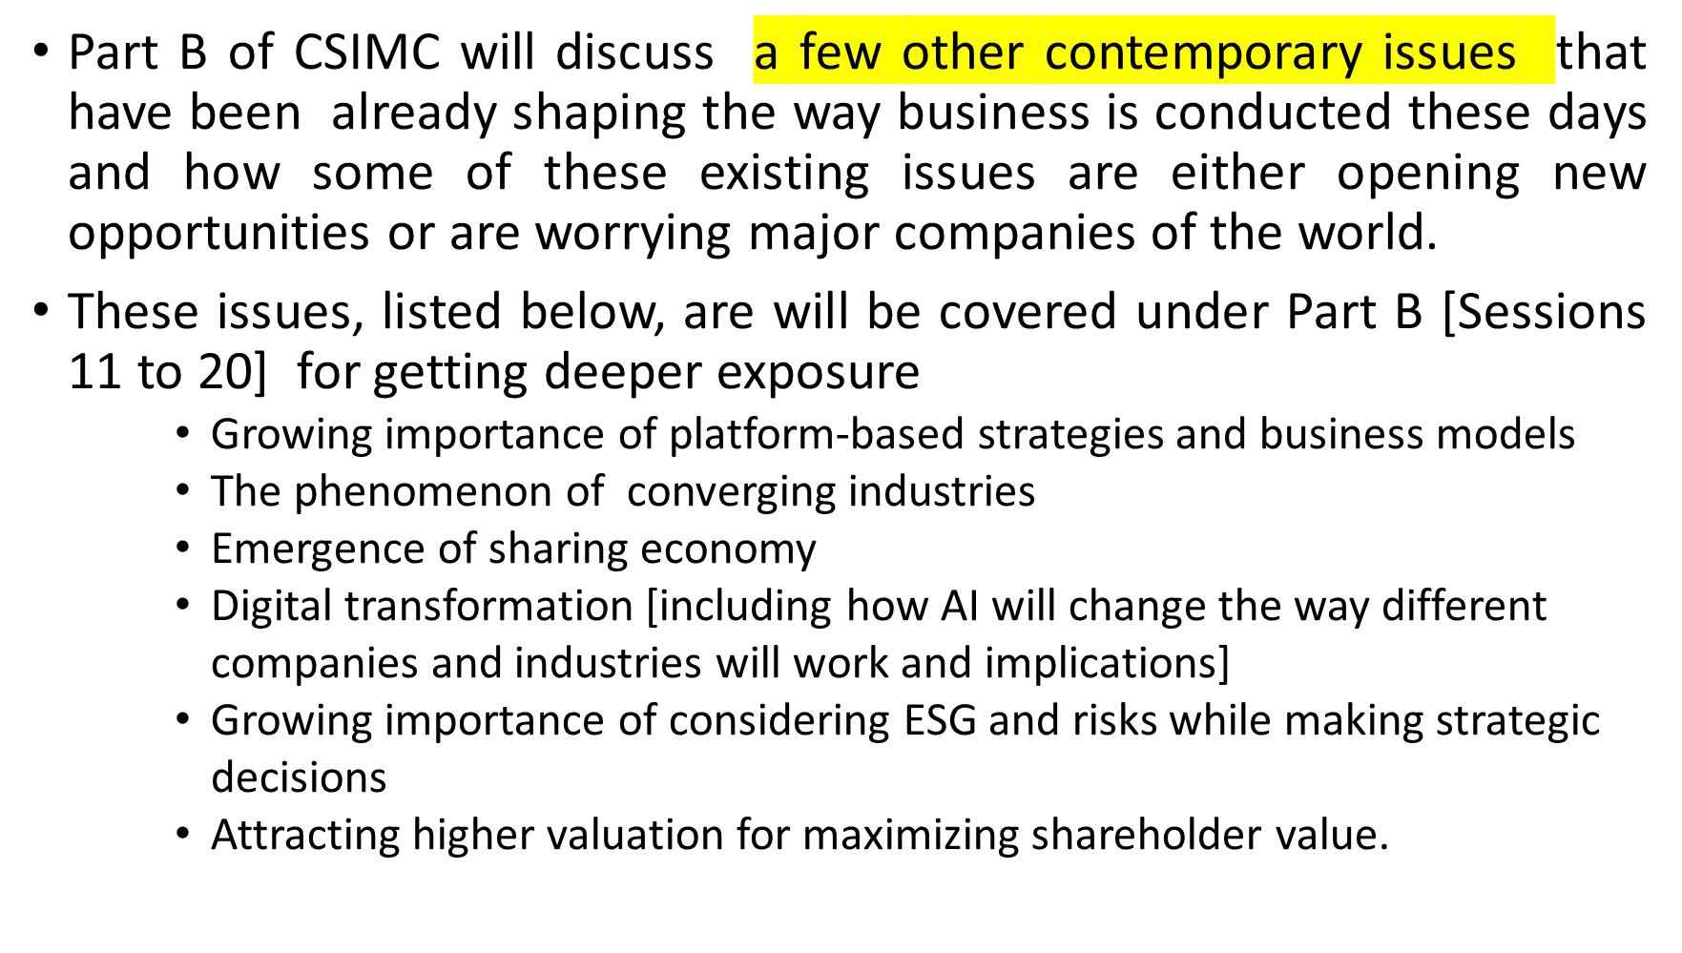
CSIMC: SCOPE OF PART B

Slide 12
Session-wise Plan
[Part A and B together]

Slide 13
PART A: 15 Contemporary Strategic Issues Facing Top-100 Global CEOs
(2026–2030): Sessions 1 to 5 [Contemporary Strategic Issues: 1-8]
No | Contemporary Strategic Issues | Level of challenge | Topic
1 | 1 2 | Tier 1[Macro and Industry Challenges] | Trade War Fragmentation Middle East Energy & Logistics Shock
2 | 3 4 | Tier 1[Macro and Industry Challenges] | 3. Recession Risk 4. Regulatory Fragmentation
3. | 5 6 | Tier 1 [Macro and Industry Challenges] Tier 2 [Strategic Choices] | 5. Shrinking Workforce 6. AI Value Gap
4 | 7 | Tier 2[Strategic Choices] | 7. Agentic AI Governance
5 | 8 | Tier 2[Strategic Choices] | 8. Cyber as Strategic Risk

Slide 14
PART A: 15 Contemporary Strategic Issues Facing Top-100 Global CEOs
(2026–2030): Sessions 6 to 10 [Contemporary Strategic Issues: 9-15]
No | Contemporary Strategic Issues | Level of challenge | Topic
6 | 9 | Tier 2[Strategic Choices] | 9. Geopolitical Strategy
7 | 10 | Tier 2[Strategic Choices] | 10. M&A and Alliances
8 | 11 12 | Tier 3 [Organizational Challenges] | 11. Scarce Skills Talent 12. New Work Models
9 | 13 | Tier 3 [Organizational Challenges] | 13. Redesigning the Organization
10 | 14 15 | Tier 3[Organizational Challenges] | 14. DEI Reset 15. Innovation Theatre

Slide 15
PART B: Other Contemporary Strategic Issues: Sessions 11 to 15
No | Contemporary Strategic Issues | Level of challenge | Topic
11 | PART B: | Other contemporary strategic issues | 16. Growing importance of platform-based strategies and business models
12 | PART B: | Other Contemporary Strategic Issues | 16. Do
13 | PART B: | Other contemporary strategic issues | 17. The phenomenon of converging industries
14 | PART B: | Other contemporary strategic issues | 18. Emergence of sharing economy
15 | PART B: | Other contemporary strategic issues | 18. Do

Slide 16
PART B: Other Contemporary Strategic Issues: Sessions 16 to 20
No | Contemporary Strategic Issues | Level of challenge | Topic
16 | PART B: | Other contemporary strategic issues | 19. Digital transformation [including how AI will change the way different companies and industries will work and implications]
17 | PART B: | Other contemporary strategic issues | 19. Do
18 | PART B: | Other contemporary strategic issues | 20. Growing importance of considering ESG and risks while making strategic decisions
19 | PART B: | Other contemporary strategic issues | 21. Attracting higher valuation for maximizing shareholder value.
20 | PART B: | Other contemporary strategic issues | 21. Do

Slide 17
EVALUATION
1] Group of Students initiated research and presentation on 15 select contemporary strategic issues covered in this course [one presentation per group – total 15 groups starting from Session 3]: 10%
2] Engagement level based on in-class CPs and case-based Quizzes: 40% [ based on CPs and 5 quizzes to take place with prior announcement – no use of laptops and smartphones during quizzes]
[ NOTE: Several industry and company specific cases [total 16] will be specially organized by the faculty for this 26-27 Course using data available from public domain and taking support of Generative AI]
2] End Term Exam: 50% [ in case some quizzes do not take place, weight of end term will go up] – closed book exam and no use of laptops and smartphones during the end term exam]

